Slide 1
Modelling fish and
macroinvertebrates off Peru
Benjamin Müller and Mariana Hill

Slide 2
Outline
Introduction: Peruvian fisheries
Introduction: Habitat modelling
First dataset (abundance)
heatmaps
seasonal movements
spatial panel model
INLA (first steps)
Random forest (absolute abundance)
Data distribution
Random forest (presence absence)
Outlook
Second dataset (landings)
Time-series prediction with RNN
Outlook

Slide 3
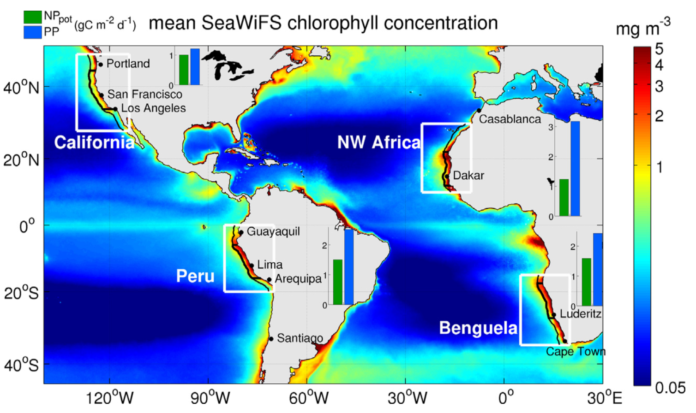
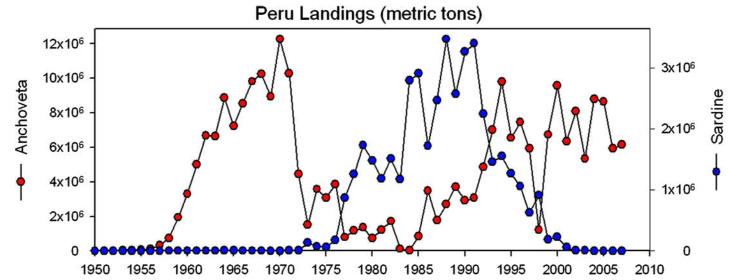
Introduction: Peruvian fisheries
Most productive Eastern Boundary Upwelling System
Small pelagic fish
Constrained by a shallow oxygen minimum zone
Largest single species fishery (anchovy)
10% of global catches
Interannual fluctuations and fisheries collapses
Environmental drivers still poorly understood
Messié & Chávez (2015)
Chávez et al. (2008)

Slide 4
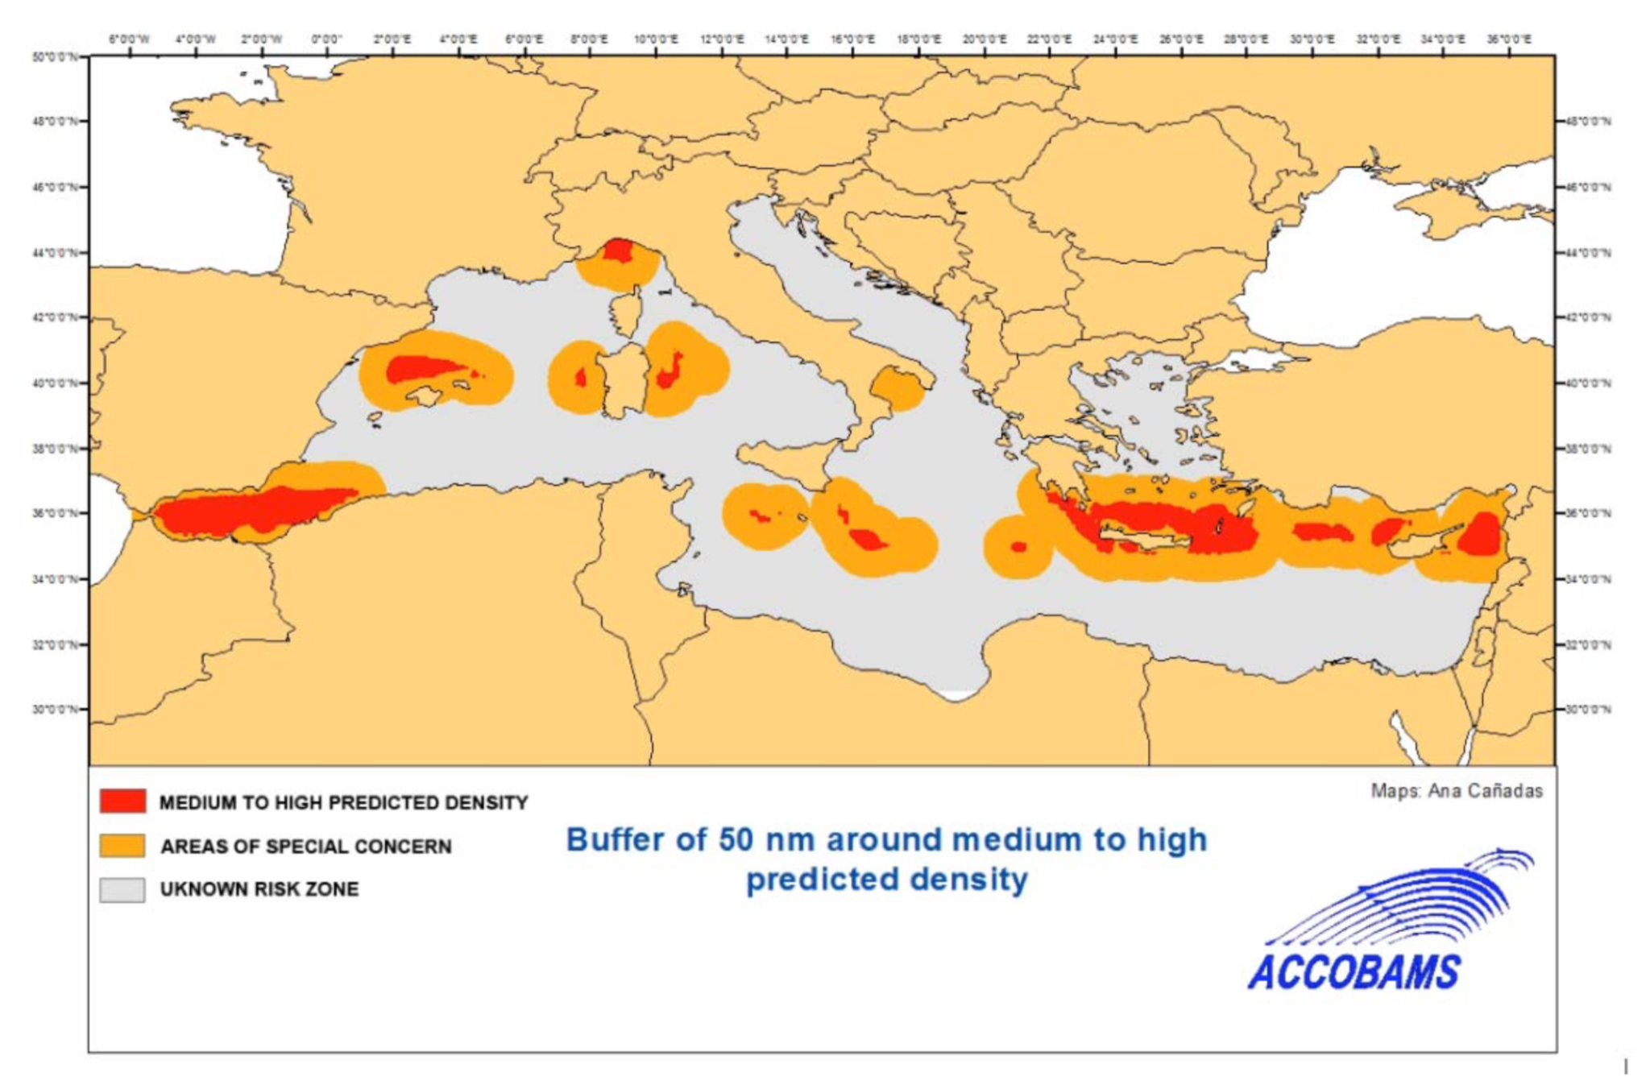

Introduction: Habitat modelling
Potential distribution of marine organisms
Common environmental variables: distance from the coast, water depth, primary production, etc.
Statistical methods (GAM and linear models)
Predictions about marine animals where more complex models are not available
Usually used as forcing for dynamic models
How does species distribution change over time?
Habitat suitability for Cuvier’s Beaked Whale (UNEP 2015)
“…the RF model was the best one for assessing Ferula gummosa habitat suitability.”

Slide 5
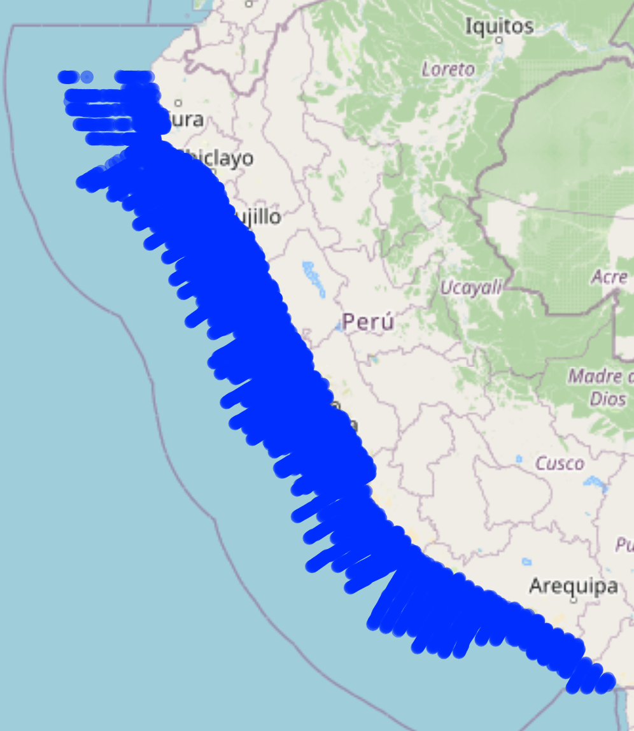
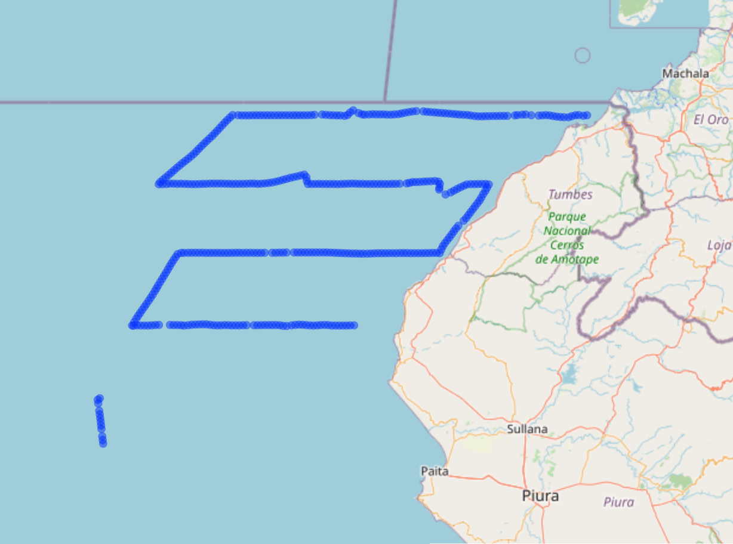
Cruises off Peru
Peruvian EEZ
Area of anchovy occurrence
Acoustic indices are used to predict total biomass over the whole region
1985 to 2012
Species:
Anchovy, sardine, jack mackerel, chub mackerel, hake, demersal fish, zooplankton, lightfish, lantern fish, Humboldt squid, catfish, white anchovy
Environmental variables:
Distance from the coast, distance from the shelf, chlorophyll, surface oxygen, water depth, depth of the oxycline, sea surface temperature, sea surface salinity
Challenges:
Spatial and temporal dataset
Sampling locations change every year

Slide 6
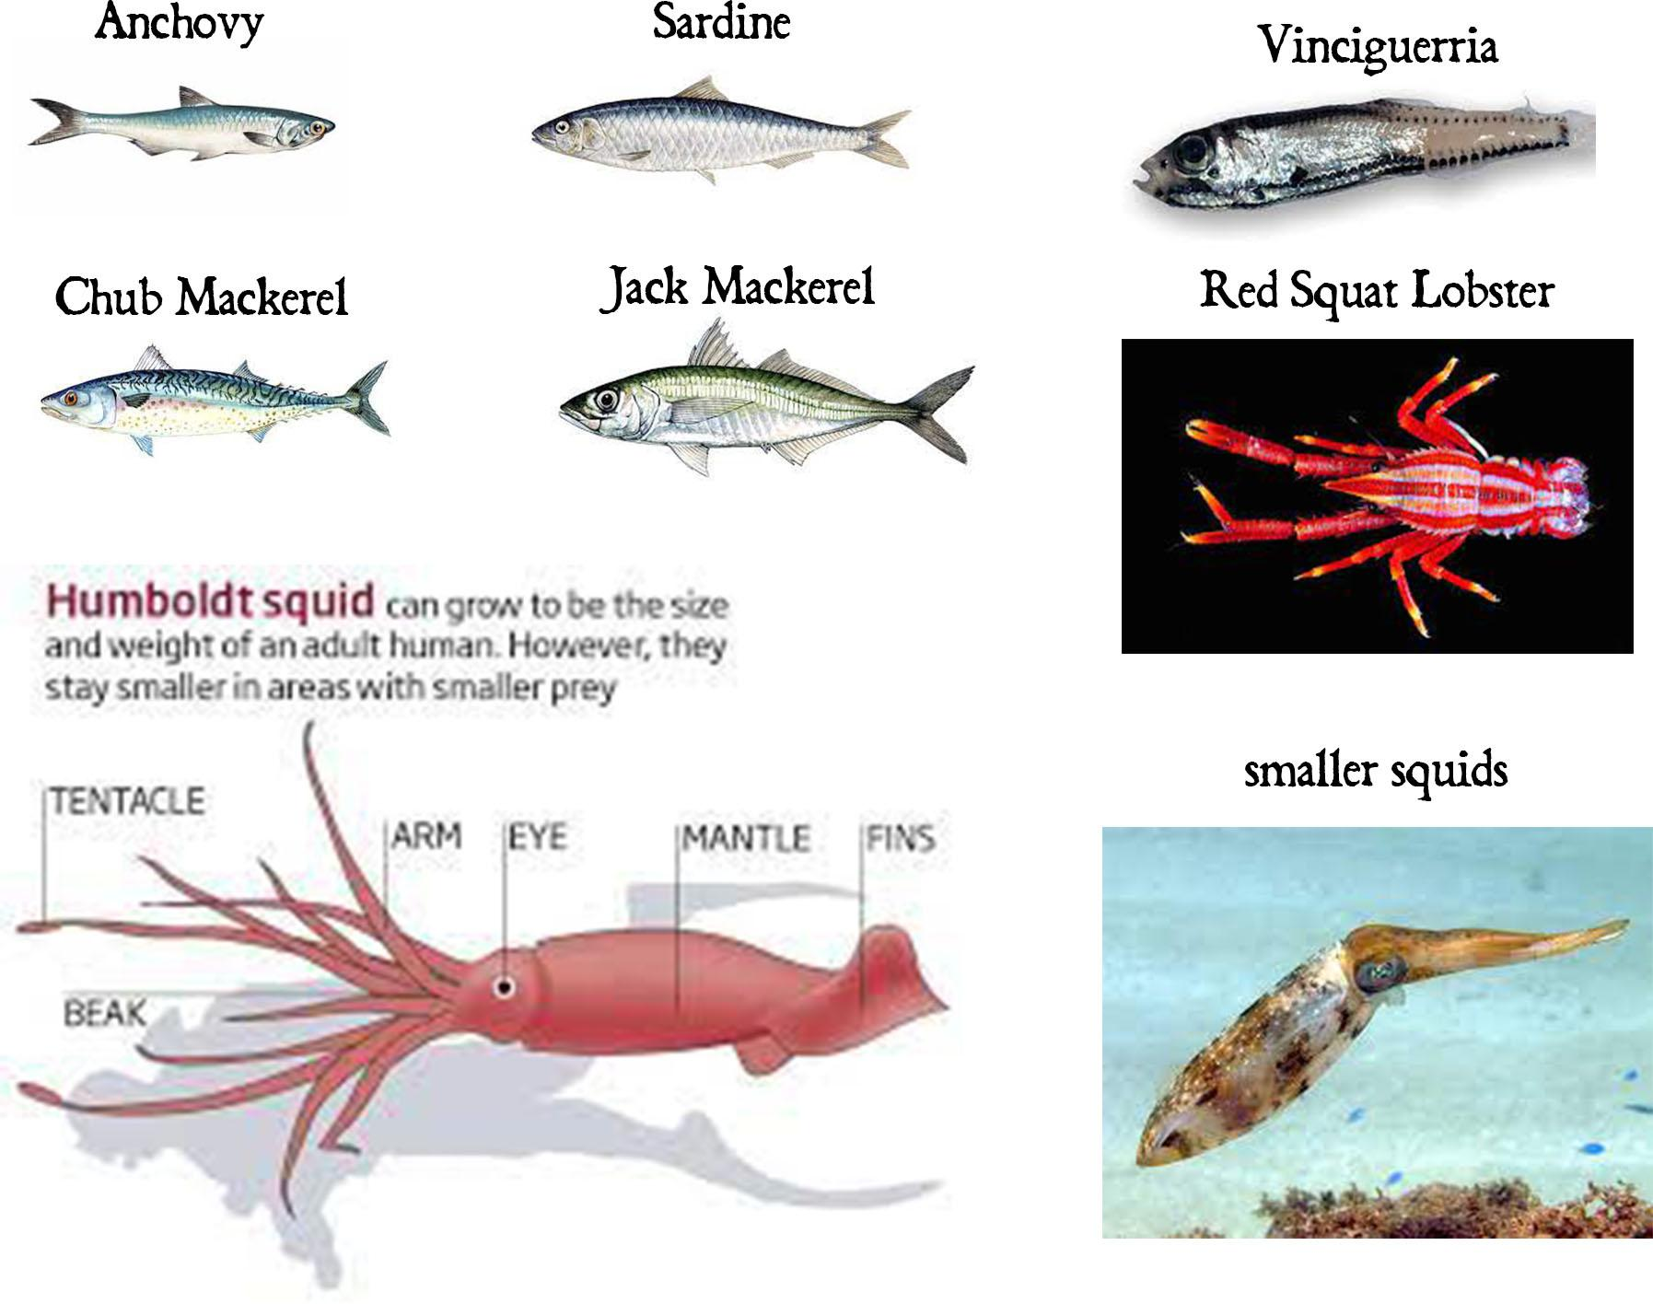
Which animals
again?

Slide 7
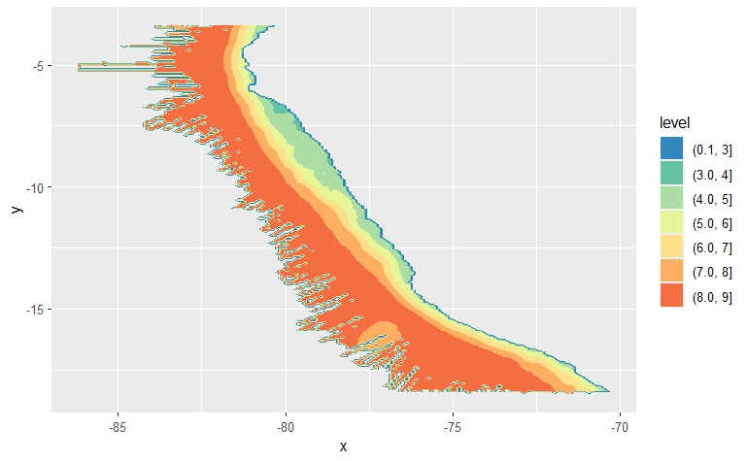
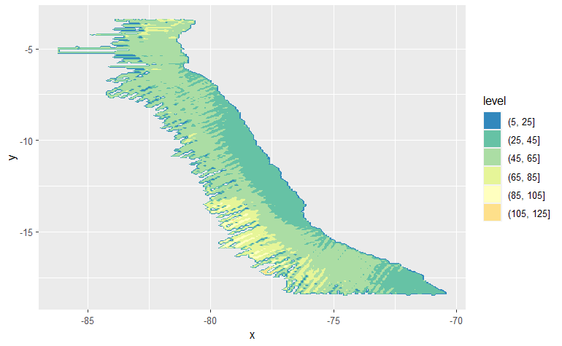
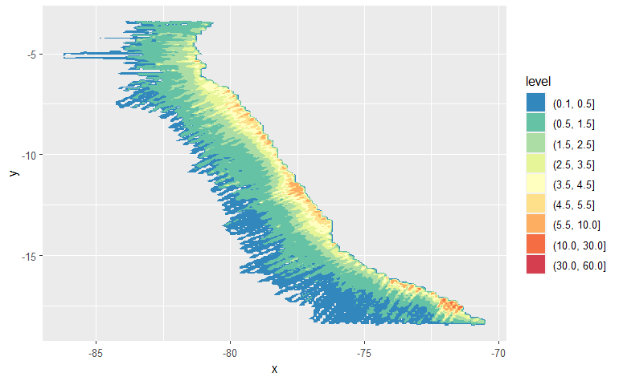
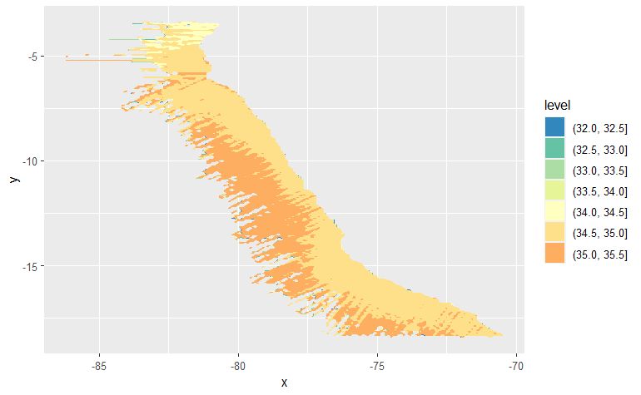
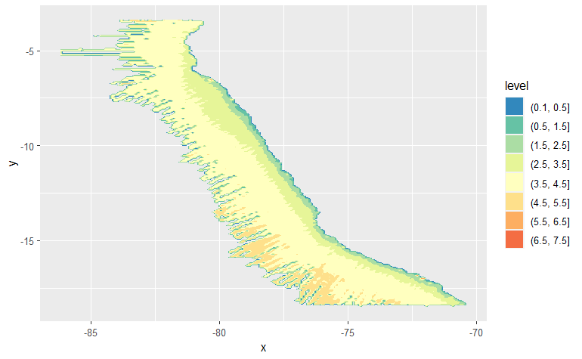
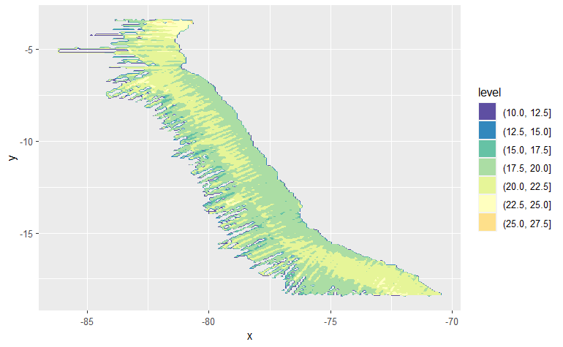
Heatmaps - explaining variables
depth oxygen chlorophyll
Surface Salinity
sea surface salinity
depth oxycline
sea surface temperature

Slide 8
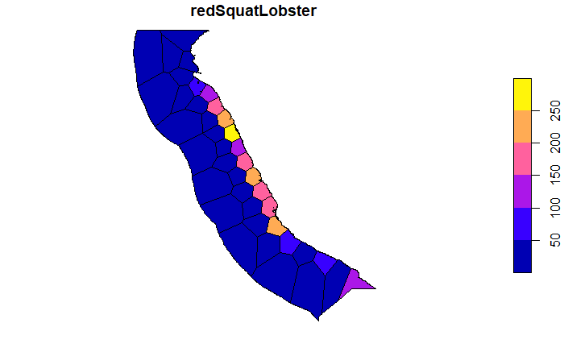
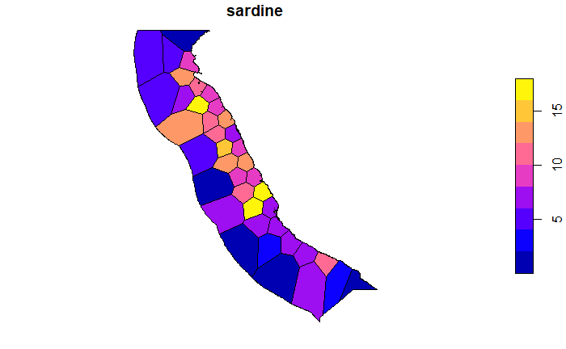
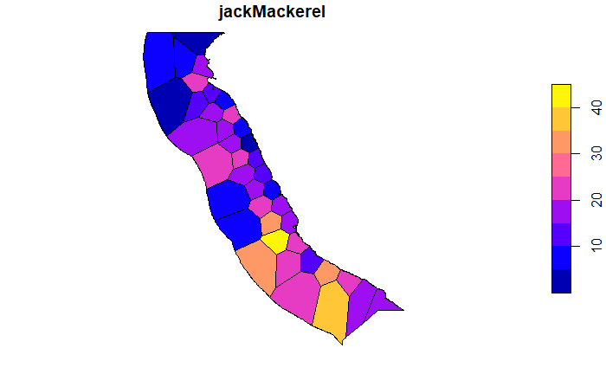
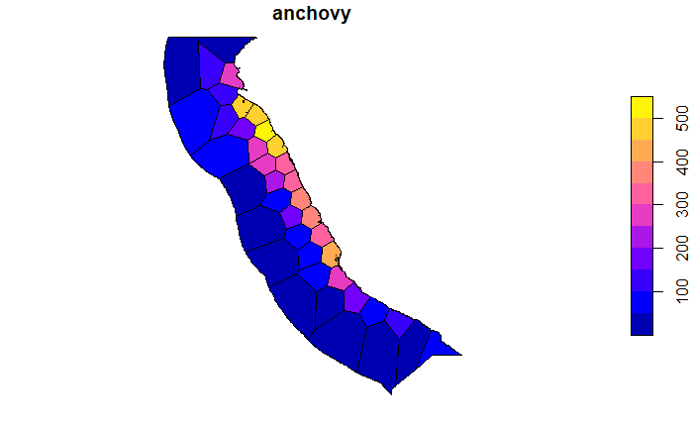
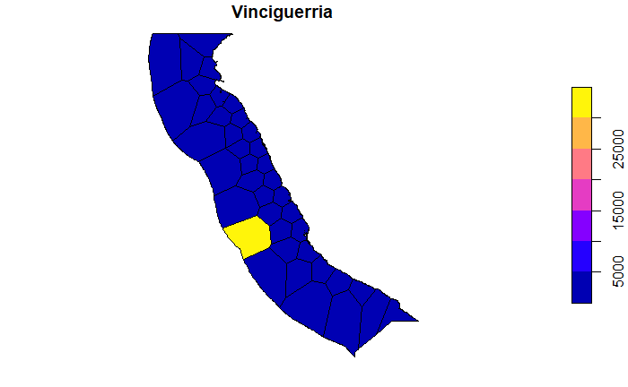
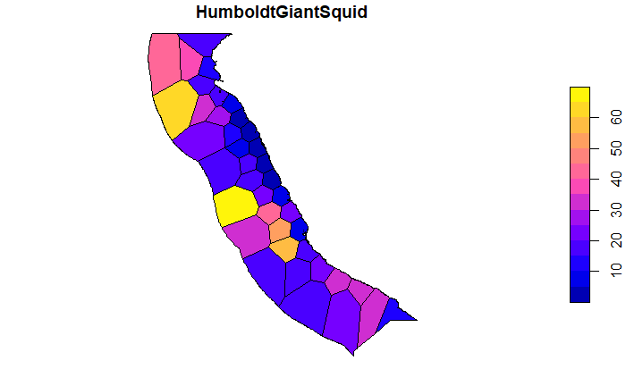
Chloropeth maps - marine animals

Slide 9
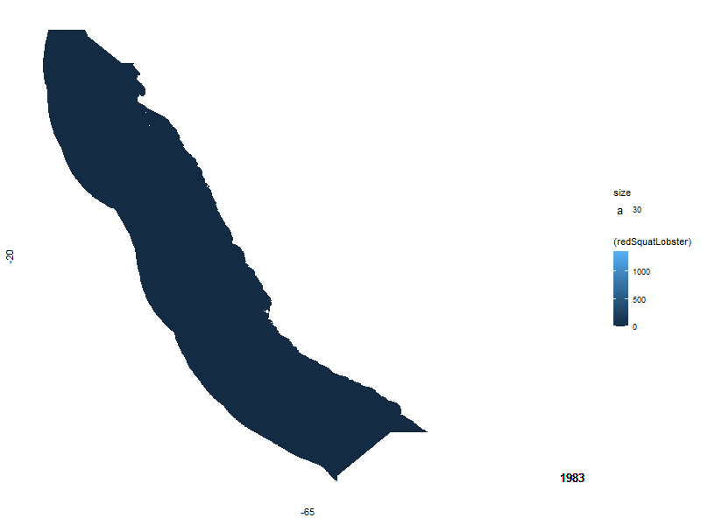
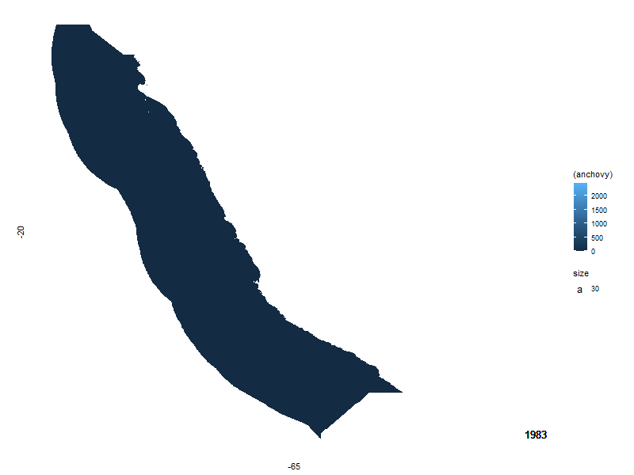
Chloropeth Maps - animation over years
anchovy over years red squat lobster over years

Slide 10
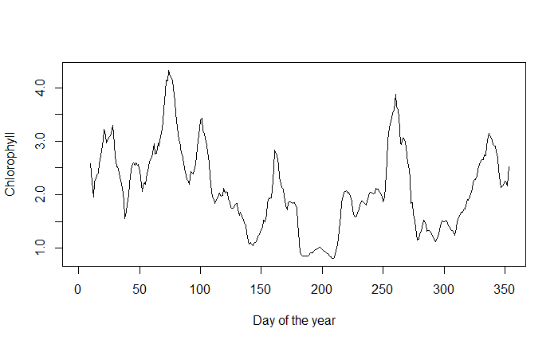
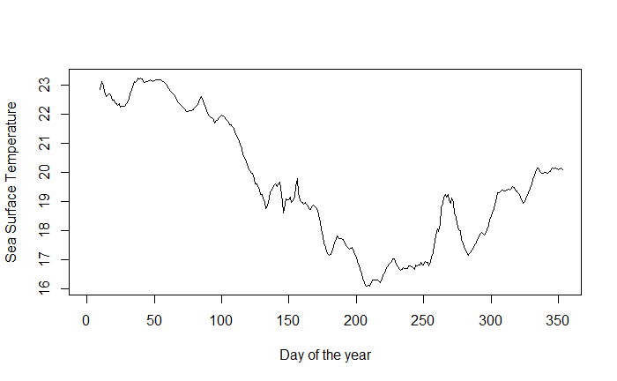
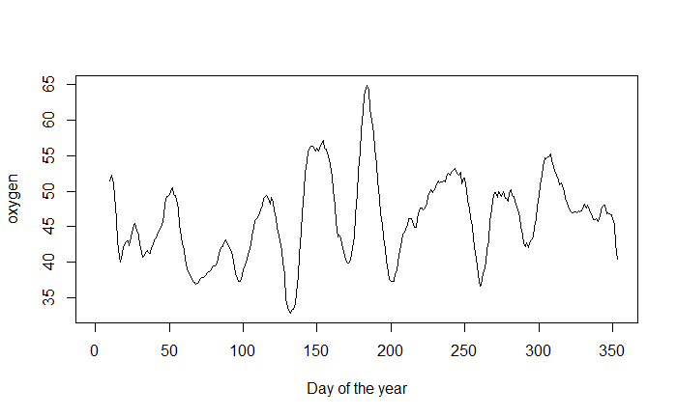
Seasonal Movements - Explaining Variables
Chlorophyll Sea Surface Temperature Oxygen

Slide 11
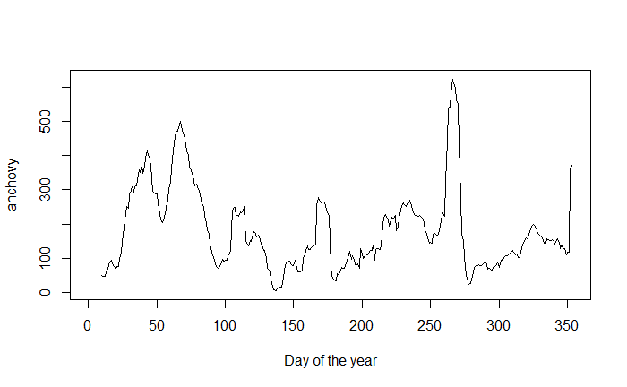
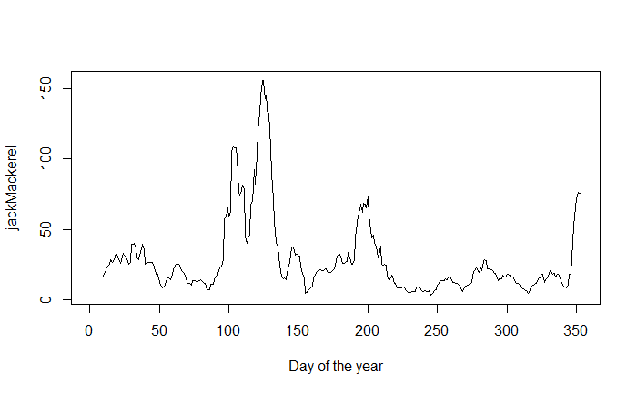
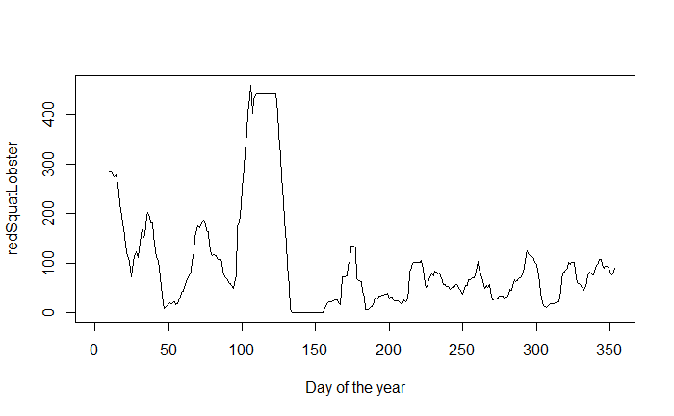
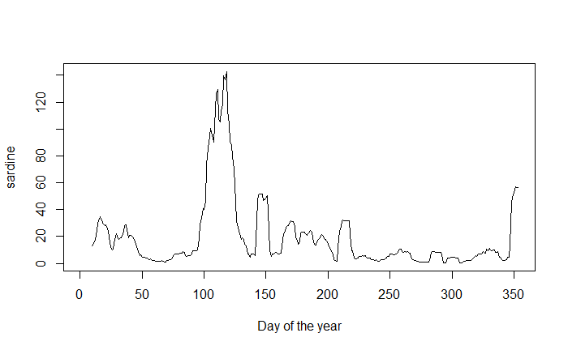
Seasonal Movements - Marine Animals
anchovy jack mackerel red squat lobster
sardine

Slide 12
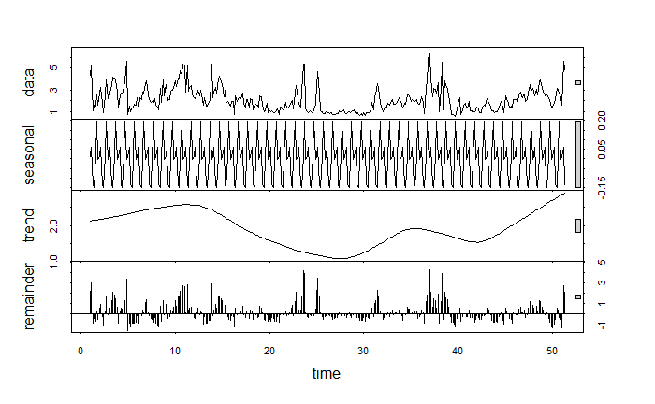
Seasonal Movements - Chlorophyll Decomposition
winter is in the middle of the year in Peru
less chlorophyll in winter

Slide 13
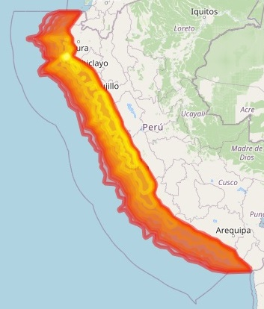
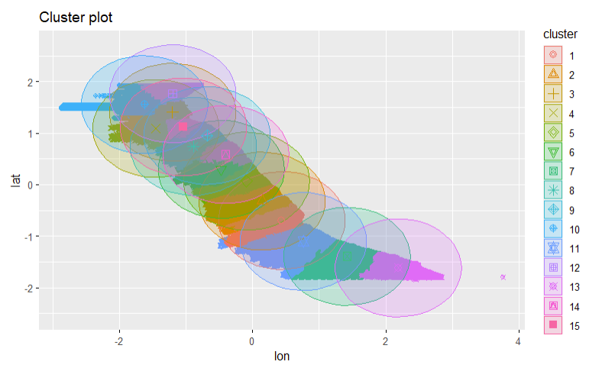
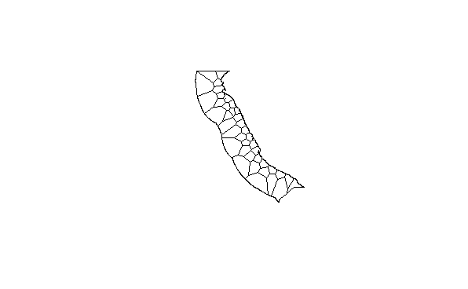
aggregation per region
create a tesselation with k means clustering and voronoi tesselation
only longitude, latitude variables used for clustering
clustering shown with k =15, voronoi with k = 40, optimal k?

Slide 14
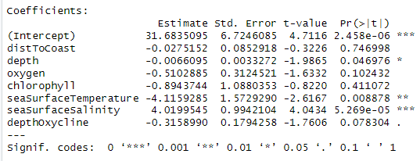
Spatial Panel Regression Results
using spatial regression alone increase R² from 0.1 to 0.8
panel data aggregated into 80 regions and 30 years
amount of red squat lobsters in dependence of

Slide 15
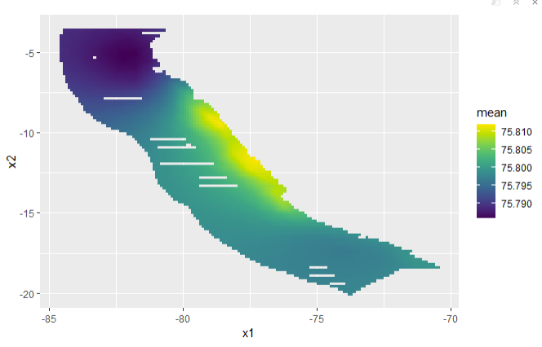
INLA - first steps - results
result is an interpolation map (kriging)

Slide 16
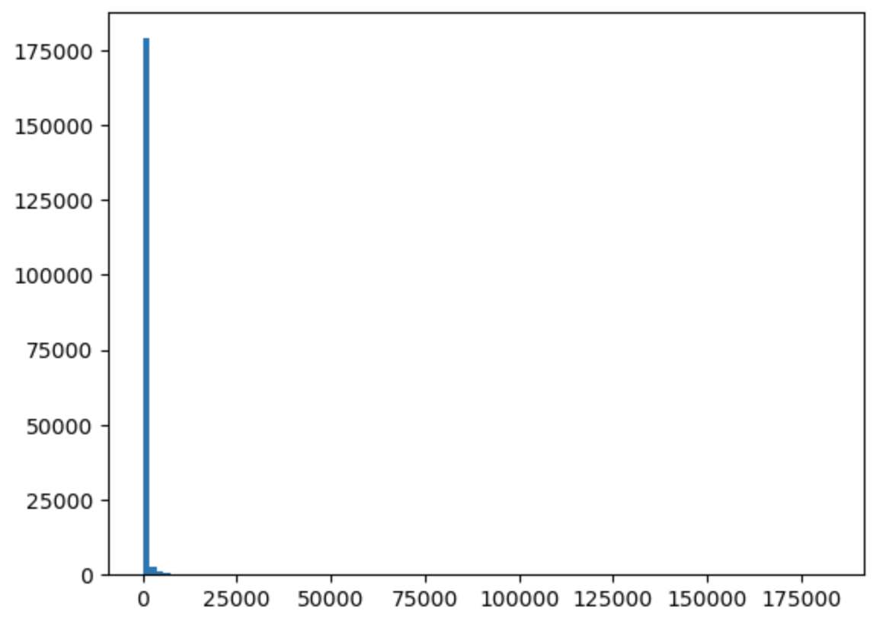
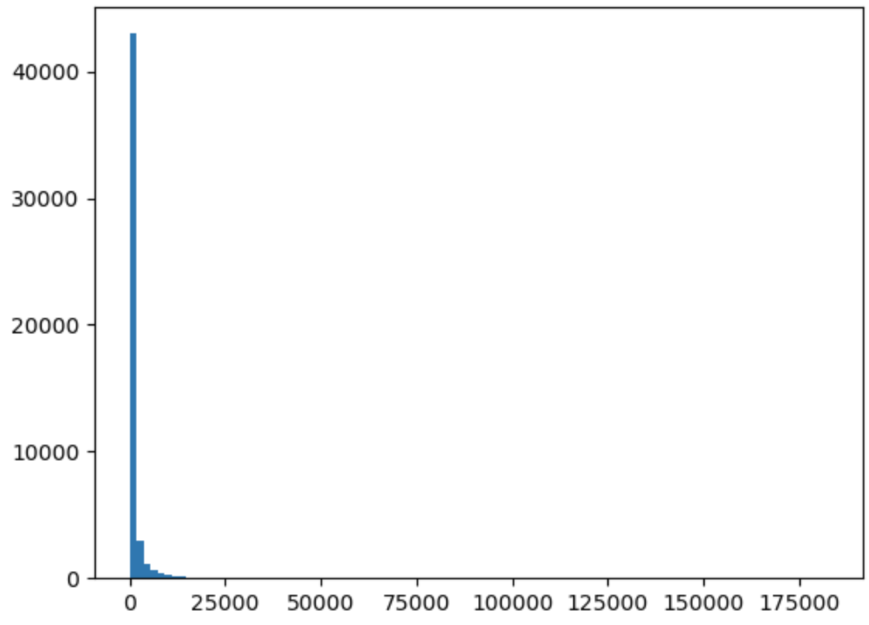
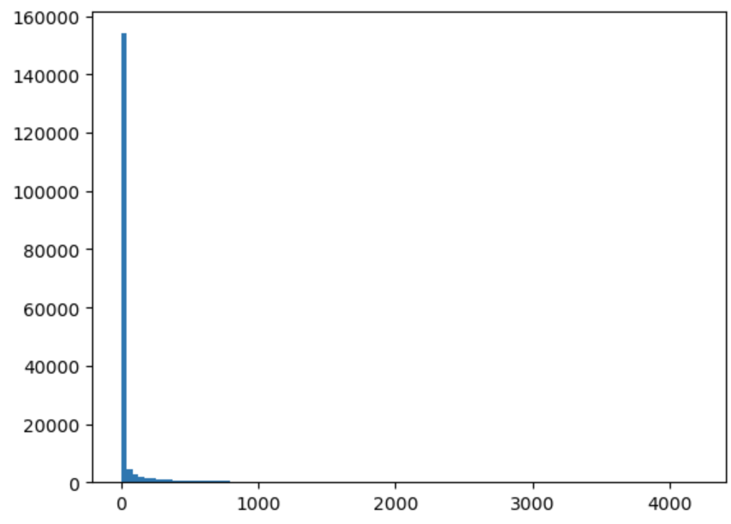
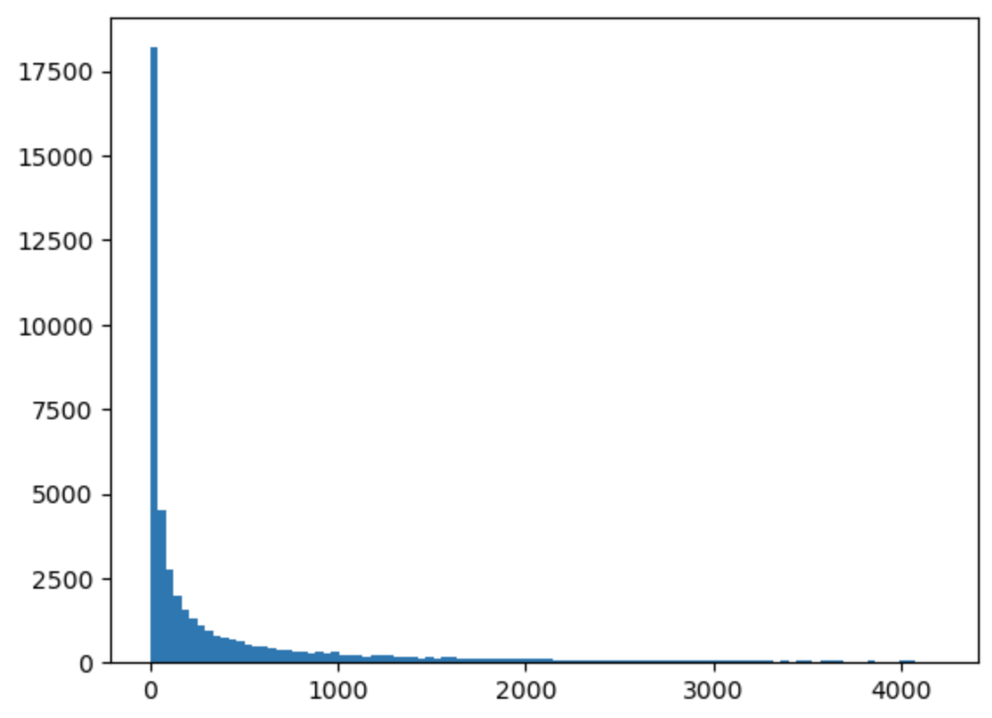
Data distribution
zeros no zeros
outliers
no outliers

Slide 17
Random forest - abundance
Without outliers, anchovy predicted abundance:
100 estimators
R2 train: 0.848
R2 test: 0.37
1000 estimators
R2 train: 0.85
R2 test: 0.37 :(

Slide 18
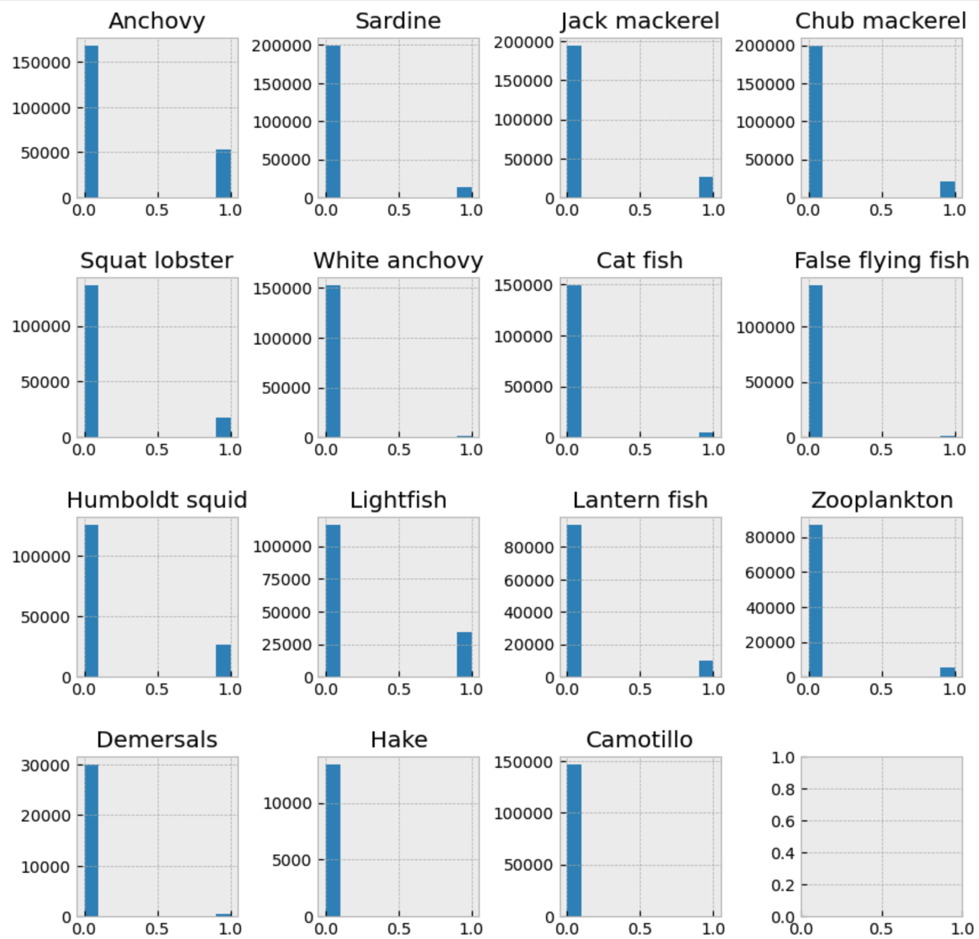
Data distribution: presence - absence

Slide 19
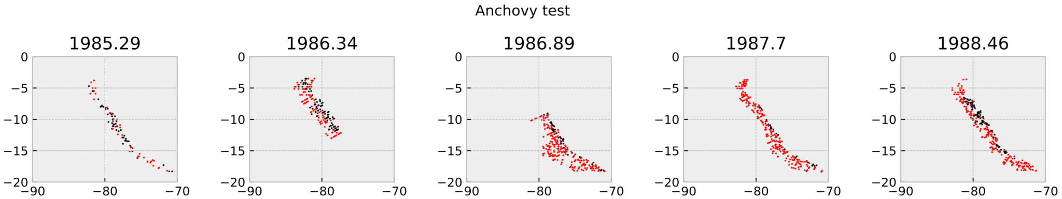
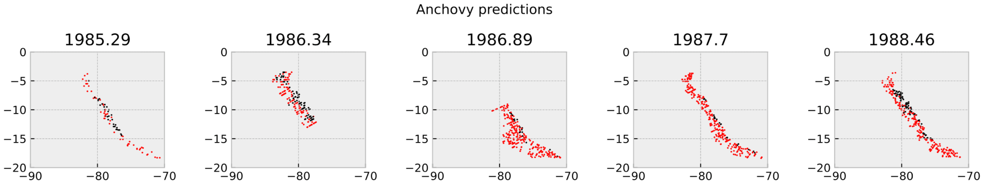
Random forest - presence absence
n estimators: 100
test accuracy: 0.96
red: absence (0)
black: presence (1)

Slide 20
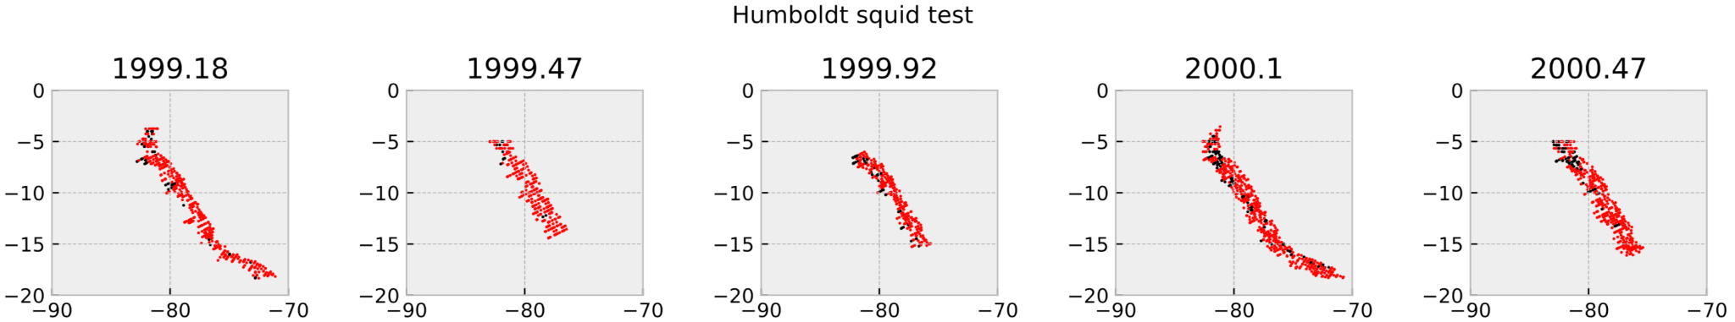
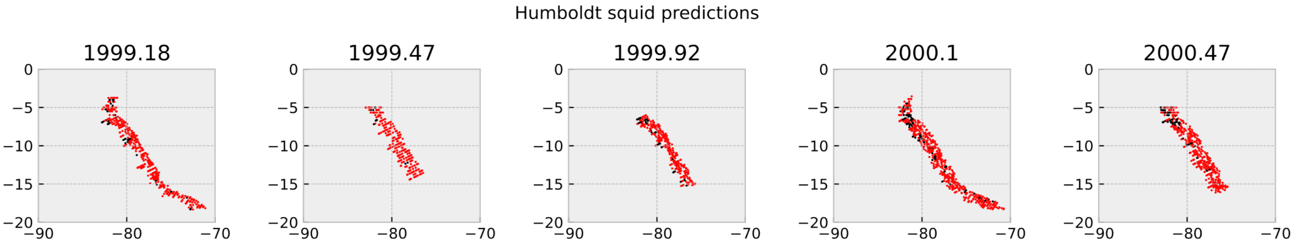
Random forest - presence absence
n estimators: 100
test accuracy: 0.97
red: absence (0)
black: presence (1)

Slide 21
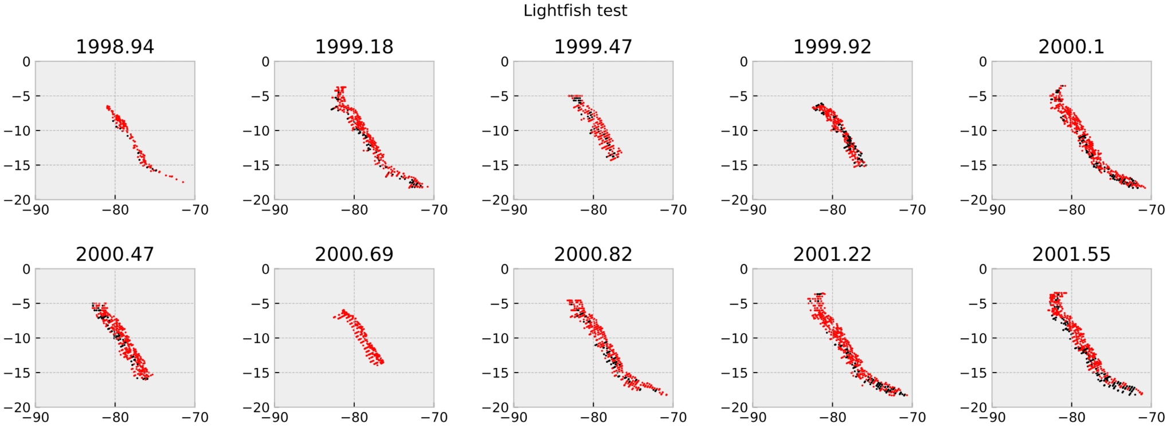
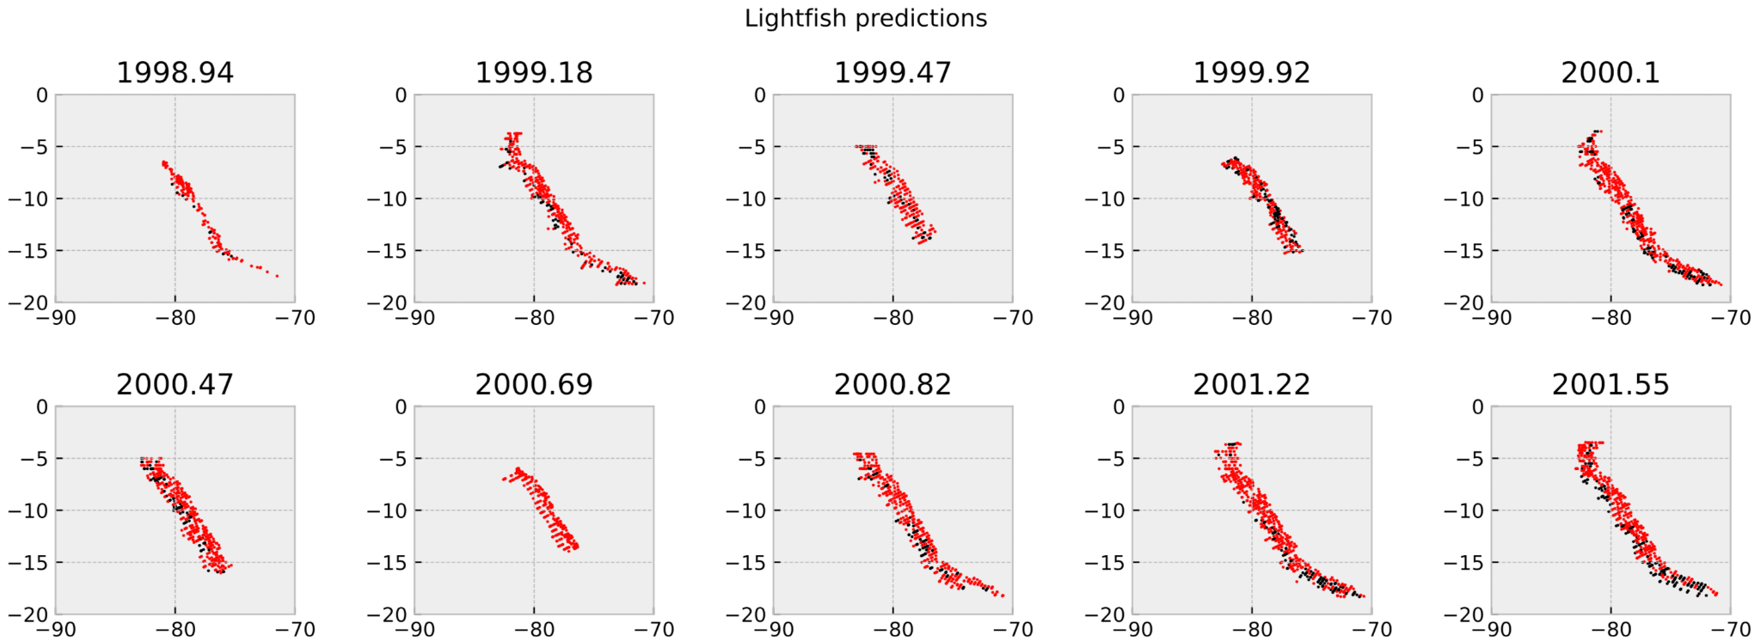
Random forest - presence absence
n estimators: 100
test accuracy: 0.97
red: absence (0)
black: presence (1)

Slide 22
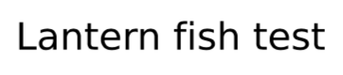
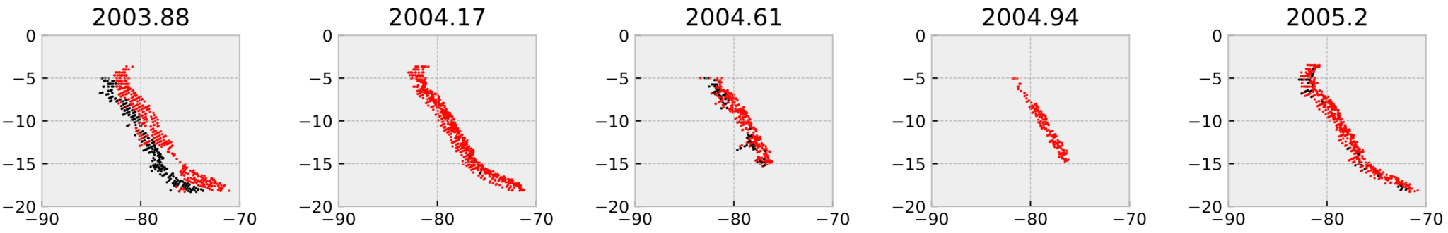

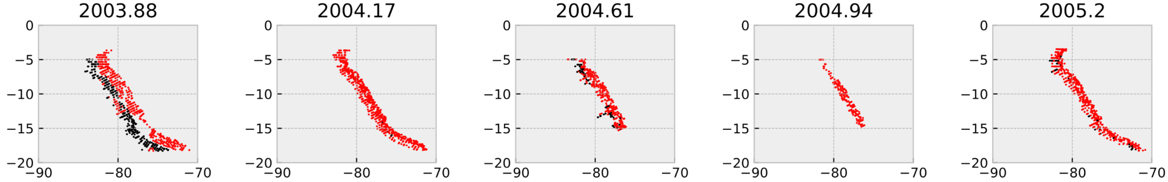
Random forest - presence absence
n estimators: 100
test accuracy: 0.99
red: absence (0)
black: presence (1)

Slide 23
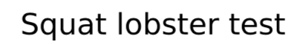
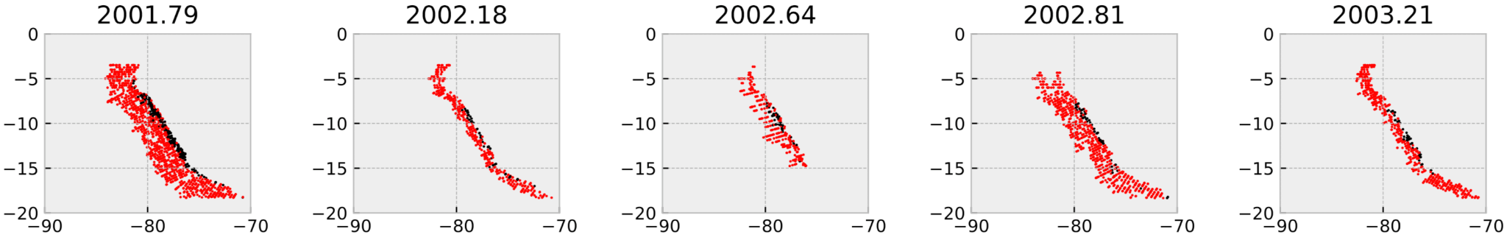
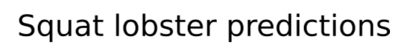

Random forest - presence absence
n estimators: 100
test accuracy: 0.98
red: absence (0)
black: presence (1)

Slide 24
Can we actually use a RF to predict the timeseries?
Train: 1985 to 1997
Test: 1998 to 2008
100 and 1000 estimators
Accuracy: 0.75
Train: 1985 to 2003
Test: 2004 to 2008
100 and 1000 estimators
Accuracy: 0.75
Precision: 0.84
Recall: 0.58

Slide 25
Conclusion and outlook
Abundance prediction does not work - not real link between observed abundance and environmental drivers
Data is highly imbalanced
Presence absence works - this is the standard method
But test and train data are too similar
The RF can’t predict the timeseries unless the data is splitted randomly
Next steps:
Get probability of occurrence instead of just presence-absence
Apply the model to predict potential fish distribution from scenarios
Refine the model - deal with very imbalanced data?
Try to predict abundance?

Slide 26

Fish landings timeseries
Yearly timeseries of landings from different species in the world downloaded from: Sea Around Us
https://www.seaaroundus.org/data/#/eez/604?chart=catch-chart&dimension=taxon&measure=tonnage&limit=10

Slide 27

Fish landings timeseries
Yearly timeseries of landings from different species in the world downloaded from: Sea Around Us
https://www.seaaroundus.org/data/#/eez/604?chart=catch-chart&dimension=taxon&measure=tonnage&limit=10
chub mackerel

Slide 28

Predicting anchovy landings with a RNN
window size: 5
train: 1950 - 1999
test: 2000 - 2019
1000 epochs
learning rate: 4e-4
y_test
prediction

Slide 29

Predicting chub mackerel landings with a RNN
window size: 5
train: 1950 - 1999
test: 2000 - 2019
1000 epochs
learning rate: 4e-4
y_test
prediction

Slide 30
Conclusion and outlook
Mean and trend are simulated but there is a mismatch between the predicted and test series
Next steps:
Try other models
Apply to more species
Use monthly data

Slide 31
Any questions?

